Slide 1
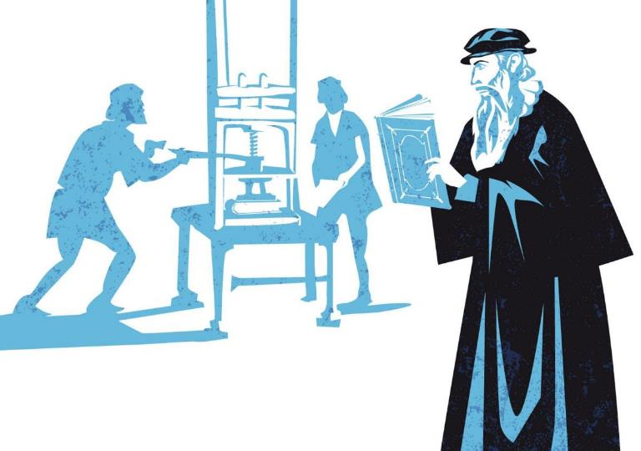
Print Culture in 17th century England

Slide 2
In today’s world access to news and information is a big part of our daily lives. Most of us are connected online 24 hours a day, using platforms such as Twitter and Instagram to keep up to date with the latest events and share our views on them.
The internet and social media has transformed the way we interact with each other and the world around us.

Slide 3
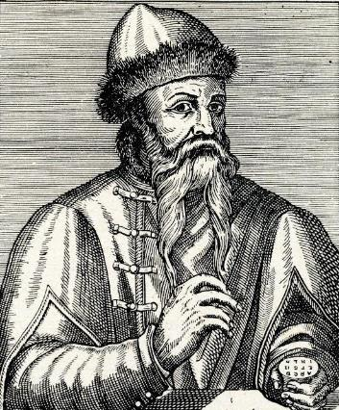
In the 15th century, a man named Johannes Gutenburg also created an invention that transformed the way people communicated information and ideas.
It was called the printing press.
Can you guess why the printing press had such a big impact on people’s lives?
Johannes Gutenberg

Slide 4
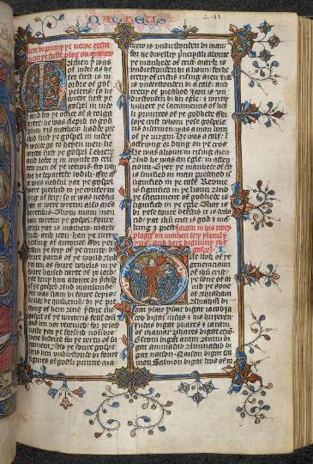
Before the invention of the printing press, books and written materials had to be copied by hand.
This meant the process for making books was not only very slow, but also incredibly expensive!
The Bible in English after the translation usually ascribed to John Wicklitre, early 15h century. British Library, Arundel MS 104.

Slide 5
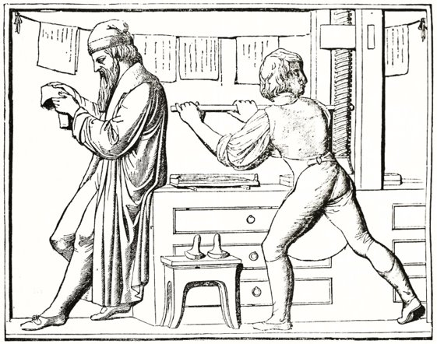
The printing press began to change that. This new machine allowed people print entire pages of text and even make multiple copies!
The printing press mechanised book production and made the whole process much easier, faster and cheaper!

Slide 6
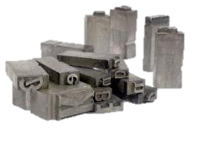
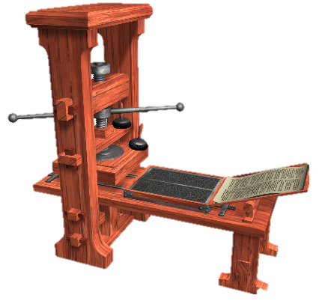
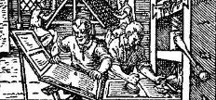
But how did the printing press work?
Firstly, the printer created a copy of the text. They did this using small metal letters, or movable type, which they arranged in a wooden tray.
A metal handle was used to apply extra pressure and ensure a clear print!
The movable type was coated in ink and a piece of paper was placed over the letters.
The printer then slid the tray under a heavy press. The pressure of the press caused the ink on the metal letters to be transferred to the paper.

Slide 7
This video from Britannica demonstrates how a Gutenberg Printing Press works:
https://www.britannica.com/video/171689/history-printing-press-work-discussion-Johannes-Gutenberg

Slide 8
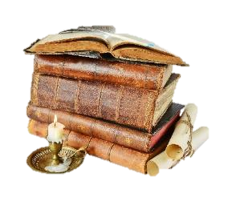
The printing press allowed for far more varied kinds of written materials to appear besides books: pamphlets, chapbooks, newsbooks and broadside ballads were some examples.
They were usually smaller in size, had fewer pages and were printed on lower quality paper. This made them cheaper than books, which were still quite expensive due to their binding and large quantity of paper sheets. Consequently these new types of prints were more accessible to a wider public.

Slide 9
Such prints were what we call ephemeral, which means that they were not necessarily made to last. Unlike books, which were regarded as items of value that would often be passed on from generation to generation, pamphlets were seen as pieces of literature made to engage with current events, they were produced fast and were to be consumed fast.

Slide 10
Think of texts and social media
What do you think the modern equivalent of ephemera is?
When you write on social media it’s usually to engage with a topic which is current or trending
You don’t create posts thinking that they are going to last and be read for generations, do you?

Slide 11
Another important characteristic of this kind of print was orality. This meant that the pamphlets were written to be spoken out loud.
There are a number of reasons why it was important for these pamphlets to sound good when read out loud. Can you think what those reasons were? Take a look at the clues below.

Slide 12
Remember, not everyone could read, and even fewer people could write, in early modern England. This was still a privilege of a few, and oral traditions - such as telling folk tales by word of mouth - were still very present in this society.
The way people read in 17th century England was different from the way we read now. It was still far more common for people to read out loud, and texts were written with that in mind.
Many of these prints were sold in the streets of London with the seller reading them out loud on the street, drawing attention even from people who could not read!

Slide 13
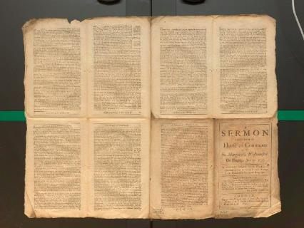
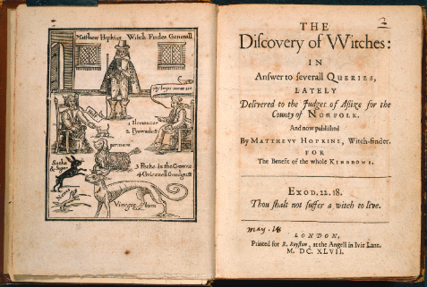
Pamphlets were a popular form of cheap literature and they could cover a wide range of topics, from politics to witchcraft, and even news (these were called newsbooks).
Example of an unfolded pamphlet, University of Liverpool Library, SPEC LGP 167 1st copy.
Example of 17th century pamphlet. British Library, Thomason Tracts, E.388[2].

Slide 14
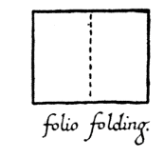
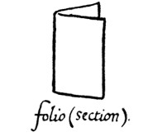
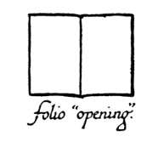
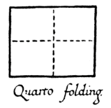
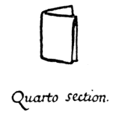
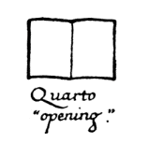
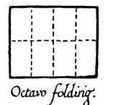
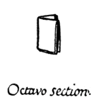
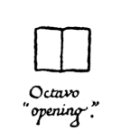
The size of a pamphlet varied depending on how many times the paper sheet was folded in order to create the pages:
A folio was composed of a sheet of paper folded only once, resulting in a larger pamphlet with 2 leaves and 4 pages of printed text.
In a quarto the sheet was folded twice, forming a slightly smaller pamphlet with 4 leaves and 8 pages of printed text.
An octavo was made by folding the paper sheet three times, resulting in a small pamphlet with 8 leaves and 16 pages of printed text.
Source: https://www.gutenberg.org/files/47089/47089-h/47089-h.htm#pageindex

Slide 15
Octavo (folded thrice)
Quarto (folded twice)
Folio (folded once)
Photo by: Clair M. L. Bourne.
Octavo: Thomas Middleton, No wit [or] help like a woman's (1657) [Wing M1985] // Shelfmark: PR2714.M7 1657 (Eberly Family Special Collections Library, PSU Libraries)
Quarto: Christopher Marlowe, Tamburlaine the greate ... the second parte (1606) [STC 17428a] // Shelfmark: PR2669.A1 1606 (Eberly Family Special Collections Library, PSU Libraries)
Folio: Fernando de Rojas (trans. James Mabbe), The Spanish Bawd (1631) [STC 4911] // Shelfmark: PQ6427.E56 1631 (Eberly Family Special Collections Library, PSU Libraries)

Slide 16
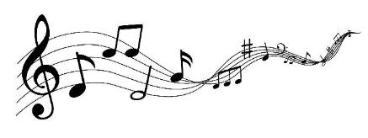
Another example of early modern english prints were the broadside ballads.
Unlike pamphlets, the broadside ballads were not folded. They were composed of a single sheet of inexpensive paper, and could also be about different topics: news, rhymes, cautionary tales and more.
They were called ballads because they often carried a musical characteristic, displaying the tone in which they should be sang out loud, for example. These were very popular, and they could be enjoyed even by those who did not know how to read - through listening to someone else singing them!

Slide 17
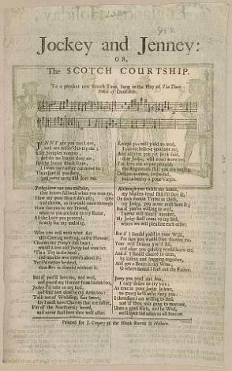
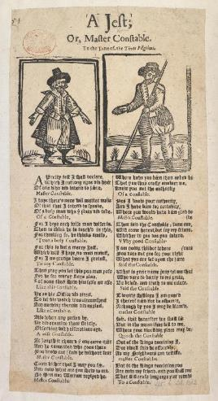
Example of 17th century broadside ballad. Pepys Ballads 5.35v.
Example of 17th century broadside ballad. British Library, Early English Books, 2123.2:208-209

Slide 18
Now watch professor Patricia Fumerton talk a little more about Broadside Ballads:

Slide 19
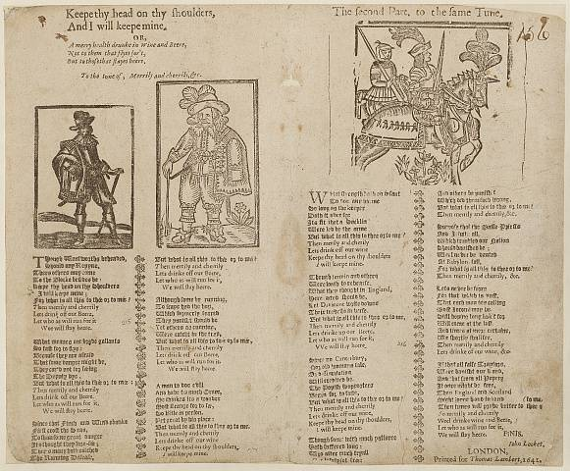
(Recording courtesy of the English Broadside Ballad Archive, record EBBA 36095: https://ebba.english.ucsb.edu/ballad/36095/recording)

